Slide 1

Software Clinic
Patrick Ballantyne, University of Liverpool
P.Ballantyne@liverpool.ac.uk

Slide 2
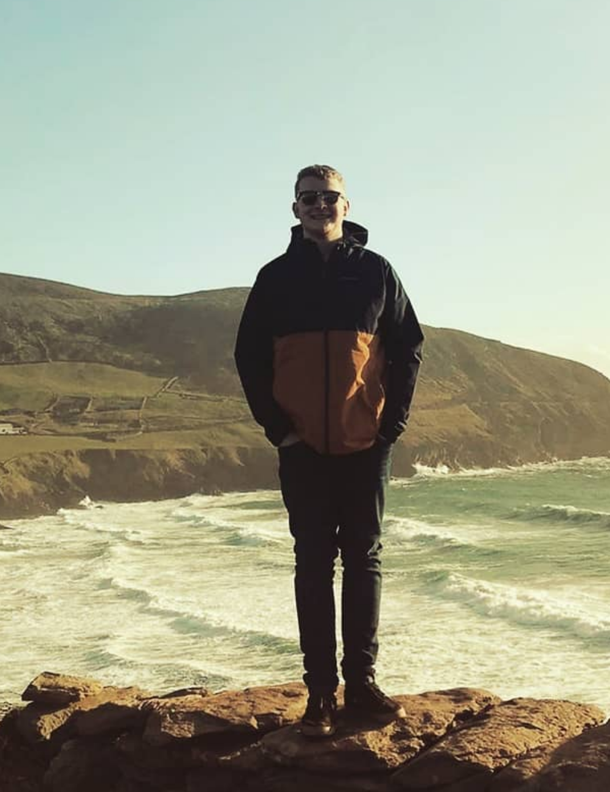
About Me
Postdoctoral Research Fellow:
Geographic Data Science Lab, University of Liverpool
Research Interests:
Retail, COVID-19, Geodemographics,
Consumer, Location and Mobility Data

Slide 3
Overview
Software Clinic

Slide 4
Overview
Introduction to R and R Studio
Libraries
Course Materials
Software Clinic

Slide 5
Overview
Introduction to R and R Studio
Software Clinic

Slide 6

Introduction to R and R Studio
Language, syntax, commands...
Software Clinic

Slide 7
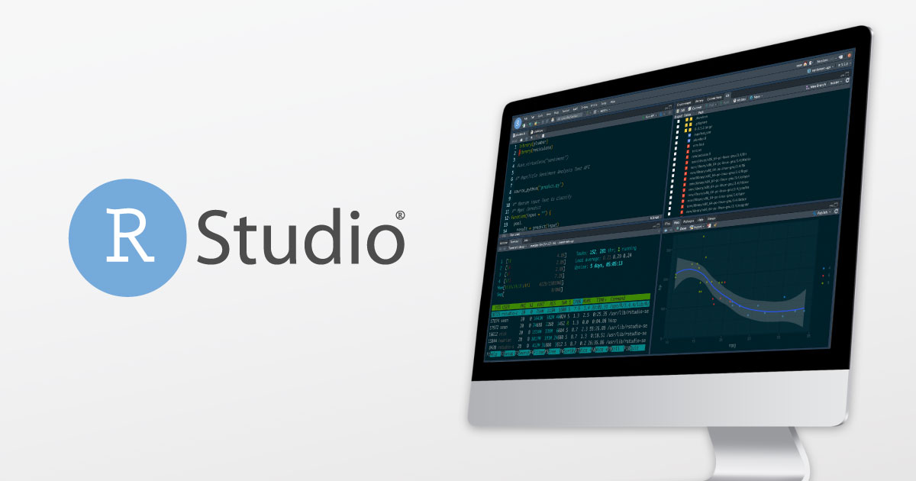
Introduction to R and R Studio
Language, syntax, commands...
Integrated Development Environment (IDE): friendlier, better functionality...
Software Clinic

Slide 8
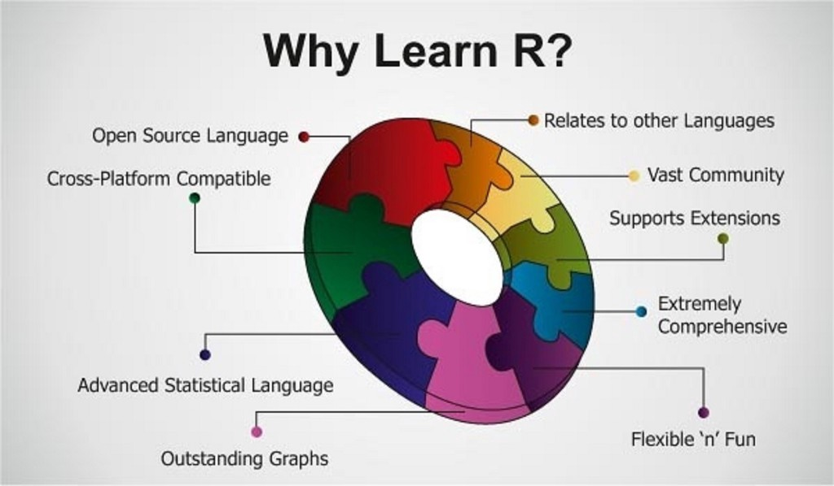
Introduction to R and R Studio
In a nutshell...
Software Clinic

Slide 9
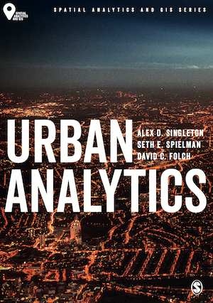
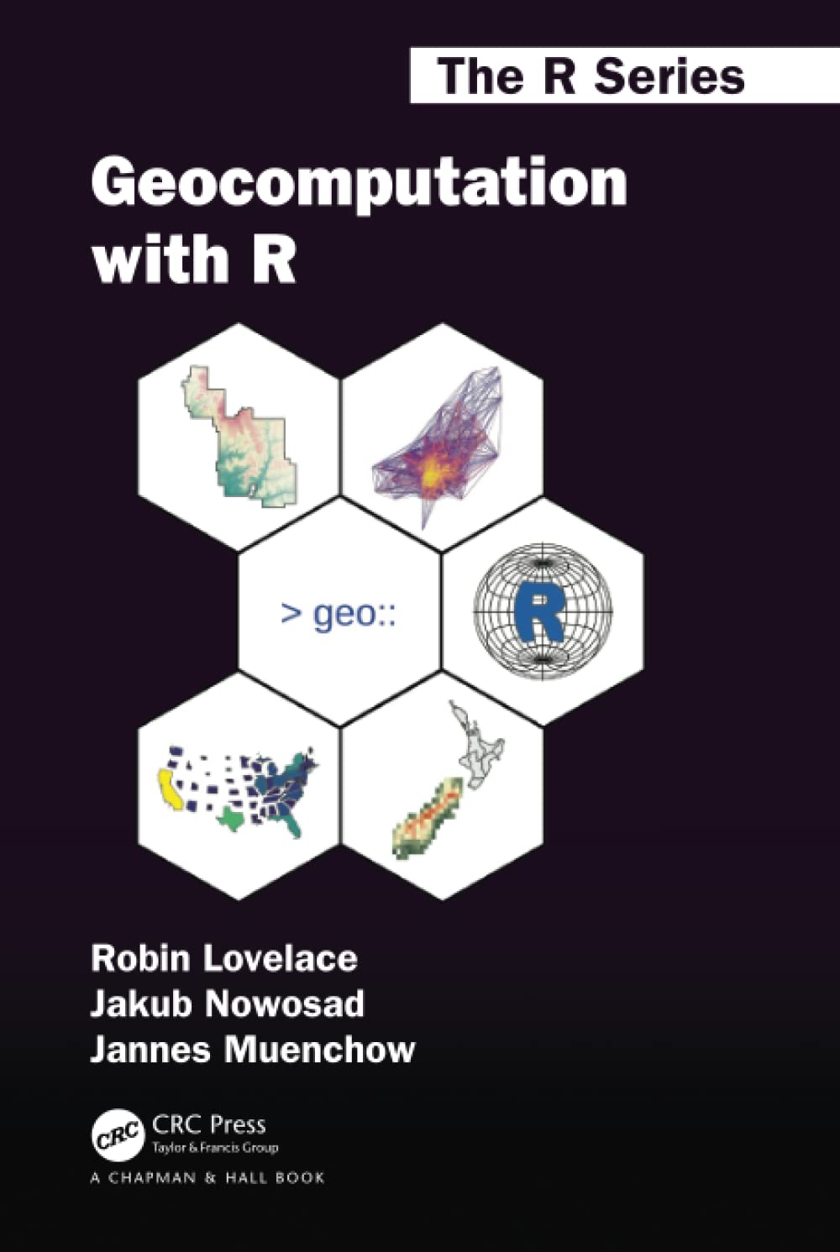
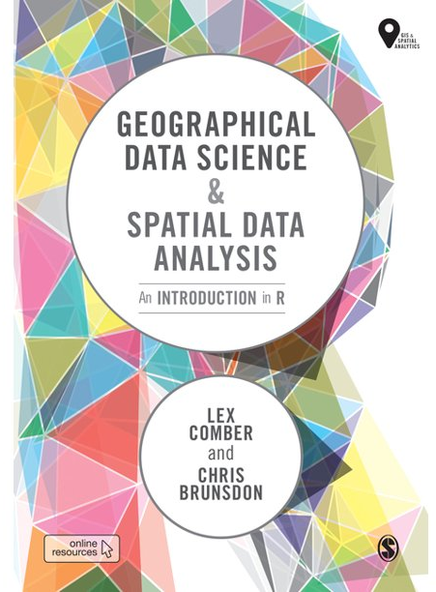

Introduction to R and R Studio
Lots of resources...
Software Clinic

Slide 10
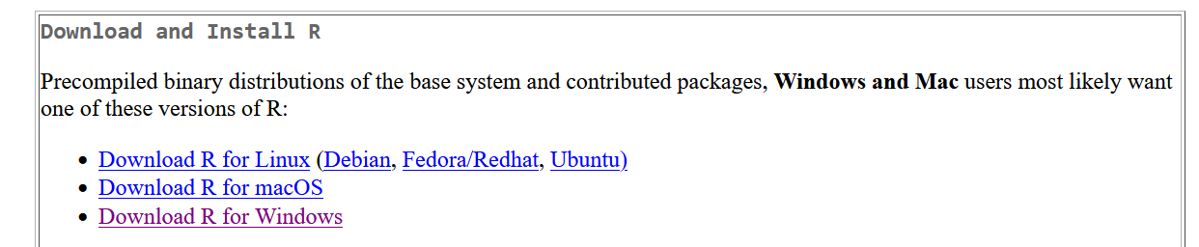
Introduction to R and R Studio
Over to you – installing R
https://cran.r-project.org/
Software Clinic

Slide 11
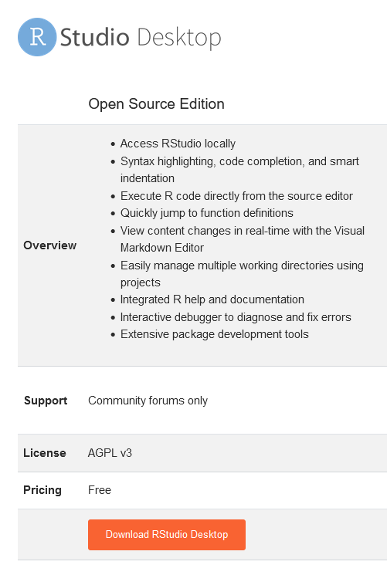
Introduction to R and R Studio
Over to you – installing R Studio
https://www.rstudio.com/products/rstudio/
Software Clinic

Slide 12
Introduction to R and R Studio
DEMO – USING R AS A CALCULATOR
Software Clinic

Slide 13
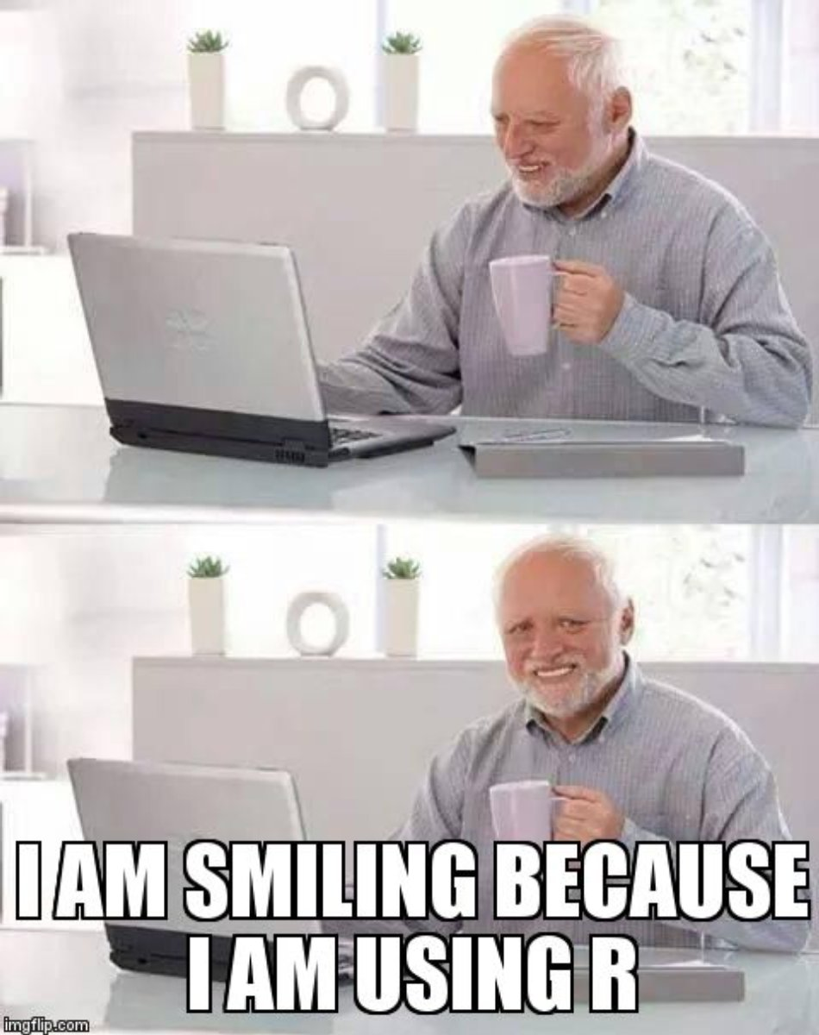
Introduction to R and R Studio
Over to you – Using R as a calculator
Software Clinic

Slide 14
Overview
Introduction to R and R Studio
Libraries
Software Clinic

Slide 15
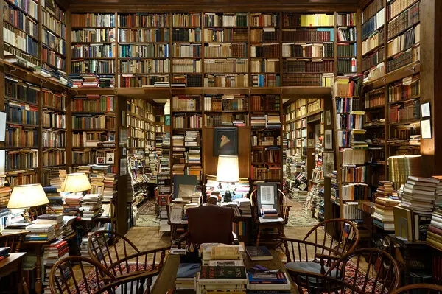
Libraries
Software Clinic

Slide 16
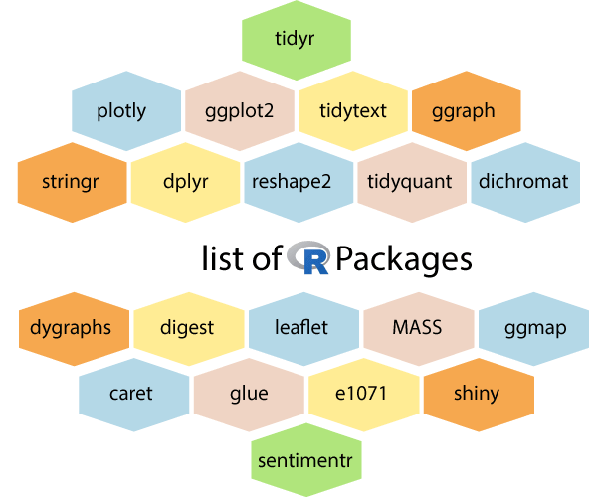
Libraries
Software Clinic

Slide 17
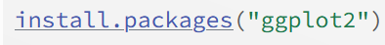
Libraries
Software Clinic

Slide 18
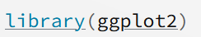
Libraries
Software Clinic

Slide 19
Libraries
Over to you – installing some packages
Package Name | Purpose
ggplot2 | Plotting, mapping, data visualisation
maptools | Advanced mapping functionality
RColorBrewer | Custom colour palettes
readxl | Importing of .xlsx files
Software Clinic

Slide 20

Course Materials
Software Clinic

Slide 21
Course Materials
https://github.com/alexsingleton/Japan_GDS_for_UA
Software Clinic

Slide 22
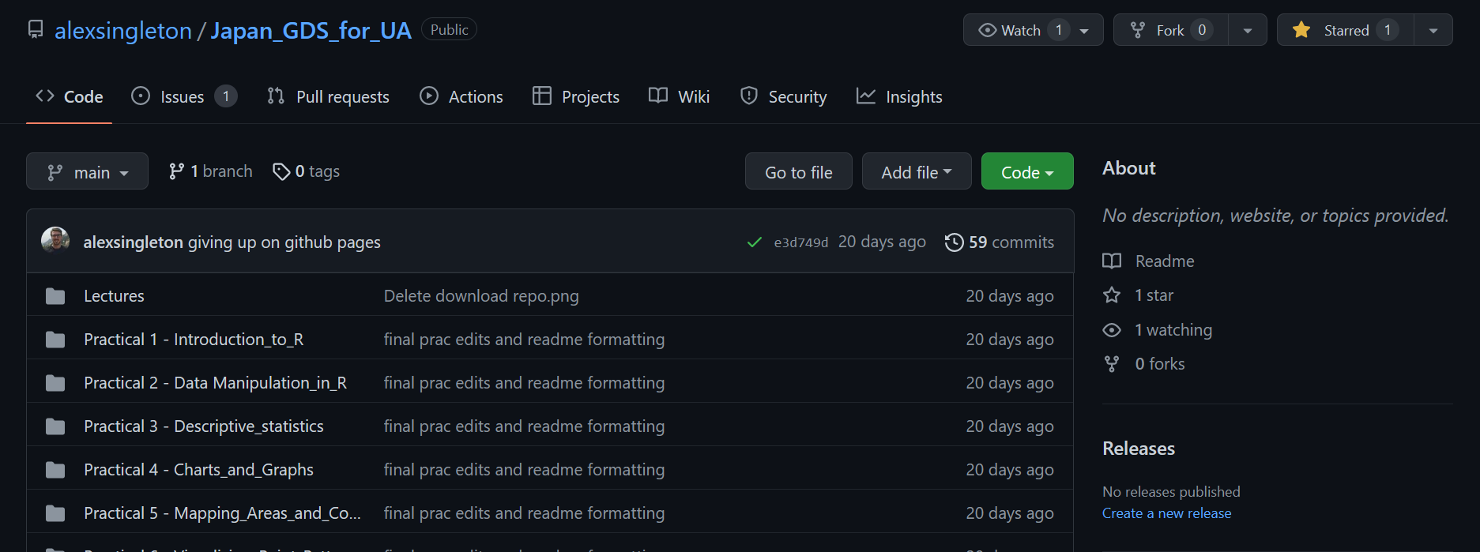
Course Materials
Software Clinic

Slide 23
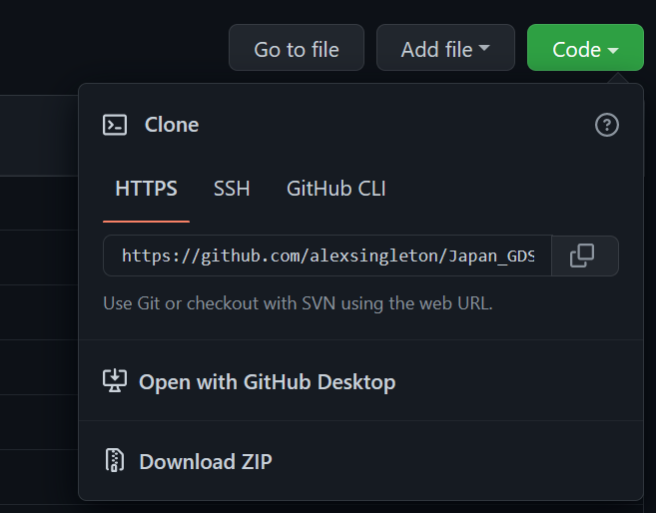
Course Materials
Software Clinic

Slide 24
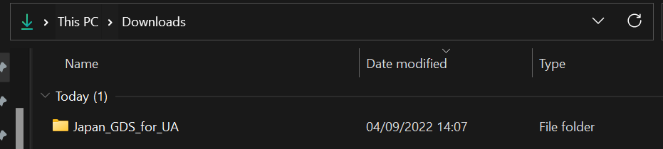
Course Materials
Software Clinic

Slide 25
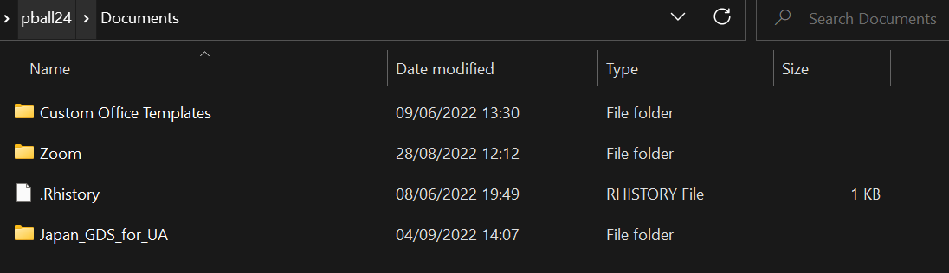
Course Materials
Software Clinic

Slide 26
Review
Introduction to R and R Studio
Libraries
Course Materials
Software Clinic

Slide 27
Software Clinic
Patrick Ballantyne, University of Liverpool
P.Ballantyne@liverpool.ac.uk

